Slide 1
State of the Industry
Lesa Francis, CSP
Chairman, ASA Board of Directors
President and CEO, Supplemental Healthcare

Slide 2

CSA Annual Conference
STATE OF THE INDUSTRY

Slide 3
Agenda
My Commitment to ASA
Industry update
ASA priorities
Legislative issues
ASA resources
Discussion

Slide 4








Corporate Partners

Slide 5

ASA Partnerships

Slide 6
Why I’m Here

Slide 7
My Journey
30 years and counting
Lots of change
Best part: the people
Notes:
I wanted to start by telling you a little of my journey in staffing. I’ve been in this industry for 30 years and counting!
(tell my history briefly…first job to now CEO)
And I’ve seen so many changes—from job boards to ATS to legislative challenges—our industry has changed much over the years.
But one thing hasn’t changed and that’s the people. The single best part of my job is the people I get to work with at Staffmark. The people we find jobs for. The people whose companies we help make more successful by finding them great people. And the people I get to meet in my role with ASA.
I am so proud to be a part of this industry because I know the GREAT things we do every day. And that’s why I’m so committed to the ASA.

Slide 8
Why I Support ASA
Strategy
Network
Best practices
Legislative support
Research and data
ASA credibility
Certification
Policy councils
Conferences
StaffingPAC
Notes:
The ASA does so much to support our industry…..

Slide 9
Industry Update
Notes:
So let’s talk about what’s happening in our industry right now … this is a great time to be a part of our industry … we have a lot of opportunity to capitalize on what is happening now …

Slide 10
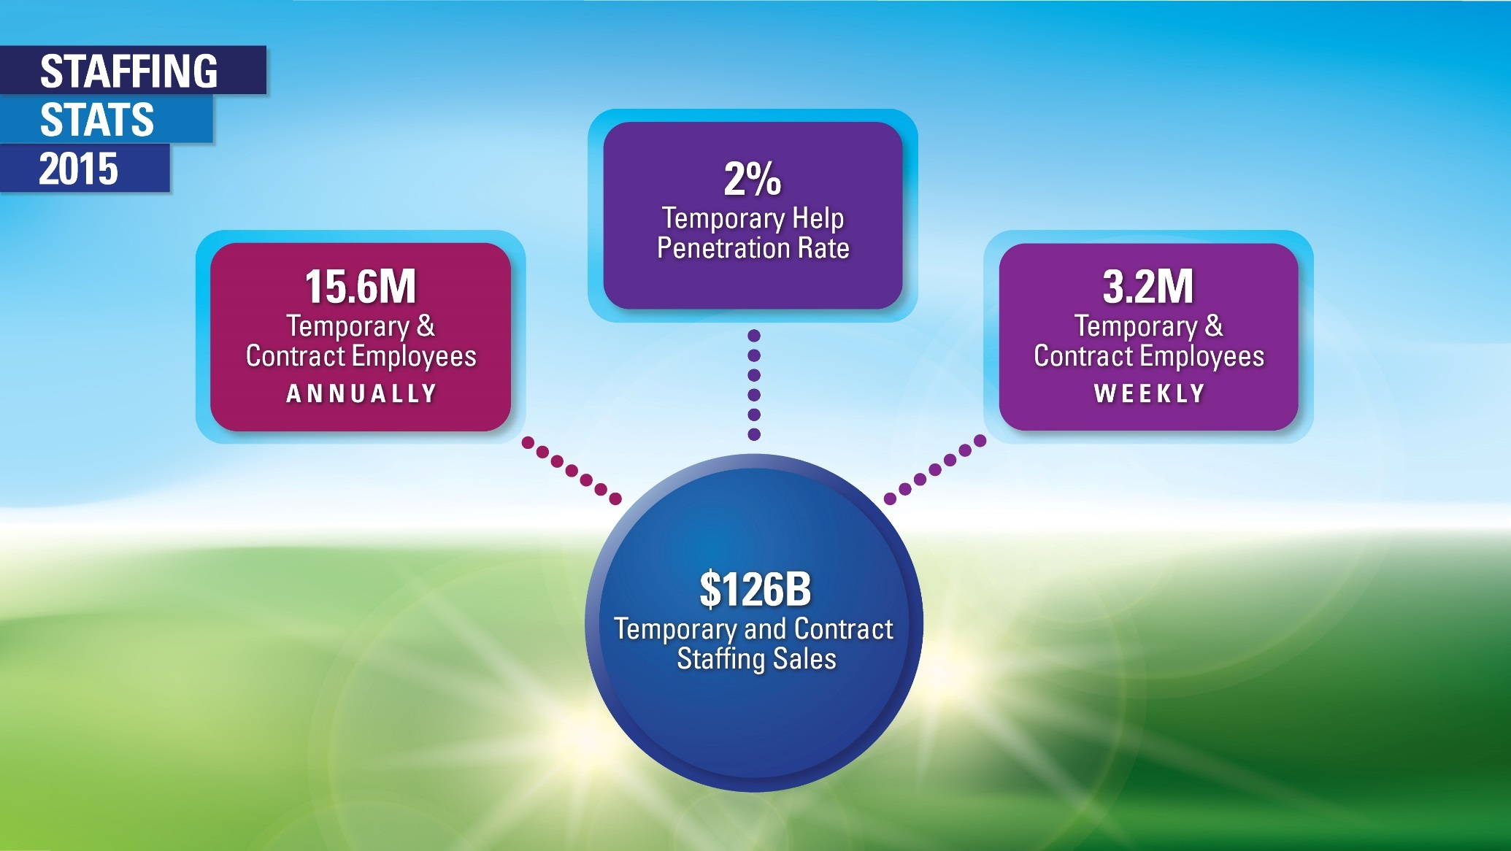
Notes:
Our industry is growing.
U.S. staffing firms hired nearly 16 million temporary and contract employees during 2015, up from 14.4 million in 2014. This translates to an average of 3.2 million temporary and contract employees placed in assignments each week—up 2.7% from 2014.
Staffing employment has continuously increased, faster than overall nonfarm employment, and has a penetration rate of around 2%.
Annual temporary and contract staffing sales in 2015 totaled $126.4 billion, up 4.1% over the prior year.
Total staffing and recruiting industry sales—including search and placement—increased 5.4% in 2015 compared with 2014, totaling $147 billion.

Slide 11

In 2015, Staffing Firms Employed
208,610 Workers in Colorado
Average number of temporary workers each week: 43,191
Annual staffing employment: 208,610
Average annual earnings per job: $39,630
Estimated number of firms: 297
Sources: Economic Modeling Specialists Intl. (EMSI), Census Bureau, American Staffing Association
Notes:
11

Slide 12
Staffing Industry Perceptions
Talent
Client
Notes:
Let’s talk now about key stakeholders perceptions of our industry – because there are some real opportunities for all of us when it comes to both the talent and client side.
Let’s start with the client side.

Slide 13
Understanding What Clients Really Think Is Key to Success
Notes:
Inavero, a great market research firm and a partner to ASA, has conducted extensive research for our industry. Many of your companies may in fact be participating in Inavero’s NPS program or be Best of Staffing winners.
According to their research, this is how clients perceive us as an industry.
But check out the last two: here’s where we both as an industry and as individual companies have some work to do. 21% of clients think we’re all the same. Almost a quarter of clients group us all together. And only 13% think that we know more about recruiting than they do. 13%! That’s our core business and only 13% of them think we can do a better job than they can.

Slide 14
Would Clients Recommend Us?

Slide 15
What Can We Do Better?

Slide 16




Let’s Talk Talent
6 in 10 Clients Have Used a Staffing Firm At Some Point for Their Personal Job Search
Notes:
Now let’s talk talent. And one key thing to remember is that a lot of times, talent can become a client. According to Inavero, 6 in 10 clients have used a staffing firm at some point in their personal job search. So how we treat our talent is critical for a lot of reasons.

Slide 17
How Talent Views Staffing
Notes:
Again, we’ve got some work to do. A third of all talent think we’re the same.

Slide 18
Would Talent Recommend Us?

Slide 19

Notes:
Traditionally, most of us have thought of our business customers as our “real” customers, as the most important group we work with it. And while we wanted to help our applicants and employees, our priority was clearly with our customers.
Well in today’s world, that has to change. Because if you don’t have the talent, you don’t have the customers. It’s that simple.

Slide 20

Notes:
We have to get to the point where we see our applicants and employees as equal in importance to our business customers.
If we want more people to think of staffing firms when they’re looking for a job, then we have to start treating them differently. We have to start acting as their job coach, their job advocate. We can’t just look at what open job orders they can fill for us, we have to look at how we can find the perfect job for them. Because if we start doing that, and if we start developing that reputation, then they’ll find us.
If we want to change the image of our industry and elevate what it means to be a temporary or contract employee, then WE have to do something different. WE have to start seeing our applicants and employees that way.

Slide 21
ASA Priorities

Slide 22
Strategic Plan
OVERALL GOAL: To position the industry as an essential driver of workforce innovation, growth, and public policy solutions by
Engaging thought leaders from diverse communities and disciplines to develop innovative workforce solutions to meet the needs of members, workers, and businesses
Promoting the industry and the value of its services to clients, workers, and the public
Offering constructive solutions to workforce issues that expand and enhance the industry’s public policy and advocacy role at the national and international levels
Creating a solution-focused public identity for the industry that better reflects the association’s expanded mission and the scope of its members’ services

Slide 23
2016 Initiatives
Weekly Staffing Stats with Infographics
Enhanced research (operations, compensation, workforce monitor)
Search and placement sector added to our quarterly survey
Revitalize Hard Facts Human Faces Campaign
ASA Cares month
Job readiness videos for JAG classroom use
Regional councils
Safety standards program

Slide 24

ASA and the National Safety Council
Notes:
ASA has been collaborating with the National Safety Council and OSHA to provide resources for our members to keep employees safe.

Slide 25
State and Federal Legislative Issues

Slide 26
State Update: Top Issues
Top Issues of 2016
  Paid Sick Leave
  Minimum Wage
  Pay Equity
  “Fair” Scheduling
  Sharing Economy
  Temporary Worker Right to Know/Notices

Slide 27
State Update: Top Legislative Issues in CO
Top Legislative Issues for Colorado in 2016
  Transportation
  Budget and Taxes
  Energy and the Environment
  Education
  Funding for Healthcare

Slide 28
ASA Policy Agenda
Workplace safety
Health care reform
Employer status of staffing firms
Immigration
Mandated leave benefits
Labor relations
Wage notice requirements
Sales tax
Unemployment insurance
Notes:
Temporary and contract staffing is one of America’s largest service industries, employing more than 14 million people each year and playing a major role in the nation’s job growth. The industry’s policy agenda is focused on laws and regulations that affect staffing firms’ ability to create jobs and serve their clients. It can be found in the Law and Advocacy section of the ASA Website.

Slide 29
ASA Resources

Slide 30

In Your Mailbox
Staffing Today
Staffing Law
Staffing Success
ASA for YOU
Online versions of Staffing Today are available at staffingtoday.net.
Staffing Law and Staffing Success are available at americanstaffing.net/digital.
Notes:
Staffing Today: Your daily source for up-to-the-minute staffing industry, employment, and economic news as well as legal and legislative updates, Staffing Today delivers critical content affecting your clients, employees, and business operation
Staffing Law: Published three times a year, keeps ASA members informed of current legal, legislative, and regulatory developments affecting the staffing services industry.
Staffing Success: The award-winning flagship publication of ASA, Staffing Success magazine delivers in-depth articles, legal analysis and scenarios, and timely data and research. Each year, Staffing Success publishes the Staffing Industry Economic Analysis, the industry’s most-anticipated report on the state of the economy and the staffing industry.

Slide 31
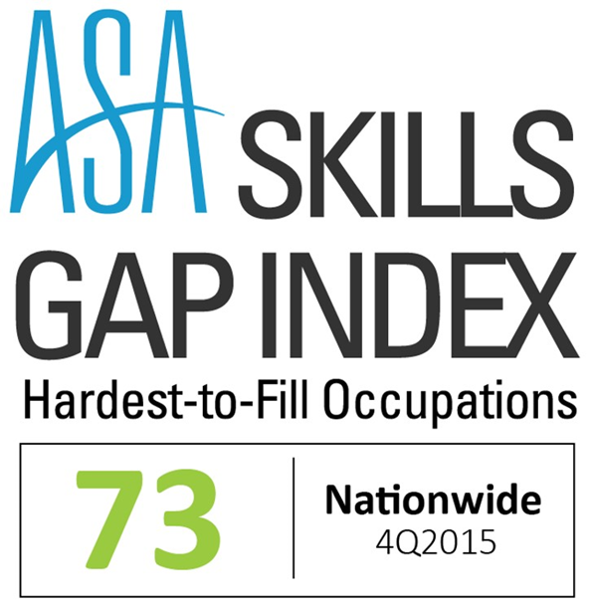
ASA Skills Gap Index
Discover The Top 10 Hardest-to-Fill Occupations Nationwide
For 4Q15, the index identified 73 occupations as hard to fill, with the top-10 most difficult being
Podiatrists
Heavy and tractor-trailer truck drivers
Photographic process workers and processing machine operators
Psychiatrists
Oral and maxillofacial surgeons
Forest fire inspectors and prevention specialists
Merchandise displayers and window trimmers
Occupational therapists
General internists
Physical therapists

Slide 32
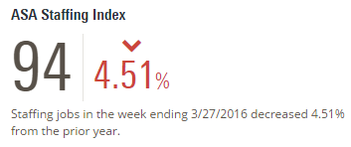
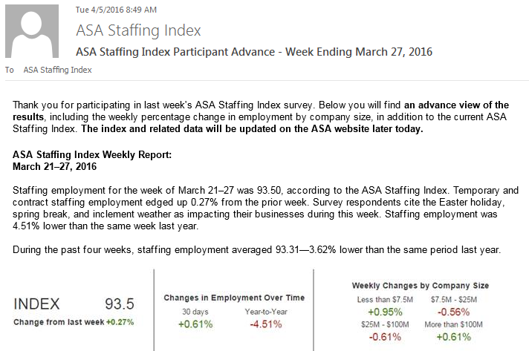
ASA Staffing Index
Provides a current snapshot of the economy
Tracks weekly changes in staffing employment
Lets you compare your company with national trends
Only three questions
Exclusive
Participant
Email Report

Slide 33
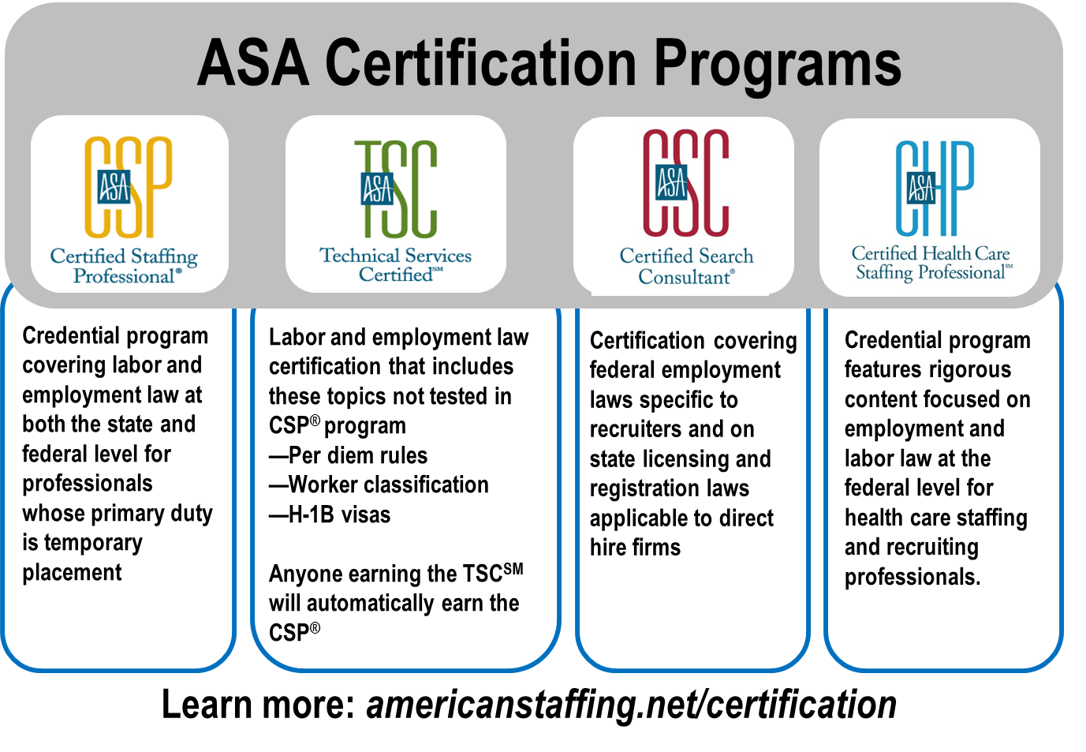
ASA Certification Programs
Notes:
NEW - CHP program features rigorous content focused on employment and labor law at the federal level for health care staffing and recruiting professionals. It is the essential credential for health care staffing professionals, certifying their expertise to work with both employees and clients within the bounds of federal laws and regulations.
NOTE: if time allows, I think it would be good for Lesa to talk about why she’s committing time and resources to having Staffmark team members get their CSP and CSC certifications. By talking about the value she sees in this, and why she herself got certified, it will have a big impact.

Slide 34

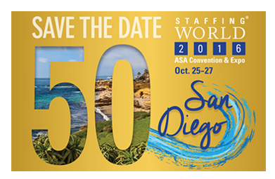



Slide 35

ASA Webinars
More than 150 live and pre-recorded webinars
Examples of content include staff retention and development, sales and business development, legal issues in the staffing industry, benchmarking, Affordable Care Act, etc.
FREE to ASA members
For information and to register, visit americanstaffing.net/webinars
Notes:
Best practices, legal updates, health care reform, how-tos, marketing, analysis and trends, and more—if there’s a topic important to staffing firms and staffing professionals, you’ll likely find it covered in ASA’s hundreds of live webinars – and recorded sessions from Staffing World and the ASA Staffing Law Conference. You can see what’s coming up on the ASA calendar of events at americanstaffing.net.

Slide 36
Best Practices
Model Contracts
General staffing model contracts
  FAQs for client questions
  Staffing industry risk philosophy
  Safety-specific clauses
Health Care Model Contract
Placement and Recruiting Model Contract
Social Media Policy
Workers’ Compensation
Safety Best Practices
Industrial staffing
Nurse staffing
Office-clerical staffing
Professional-managerial staffing
IT staffing
Publications
Staffing Success magazine
Staffing Law
Staffing Today

Slide 37
Information at Your Fingertips
Federal and state pending legislation
Staffing-specific laws
State E-Verify laws
ASA legal analyses

Slide 38




Follow ASA
@StaffingTweets
americanstaffing.net/facebook
americanstaffing.net/linkedin
americanstaffingassociation

Slide 39
Closing Remarks

