Slide 1
Once Upon A Time
Time Management is No Fairy Tale

Slide 2
FOCUS RECRUITING WEEK
Time | MON | TUE | WED | THU | FRI | SAT
7:30 AM | Top Producers show up early
8:00 AM |  |  |  |  | All Submittals Done & Weekly Updates | Over Achiever Time
8:30 AM
9:00 AM | FOCUSED ACTIVITY | FOCUSED ACTIVITY | FOCUSED ACTIVITY | FOCUSED ACTIVITY
9:30 AM
10:00 AM
10:30 AM
11:00 AM
11:30 AM
12:00 PM | Lunch | Lunch | Lunch | Lunch | Lunch
12:30 PM
1:00 PM |  |  |  |  | PLANNING
1:30 PM | FOCUSED ACTIVITY | FOCUSED ACTIVITY | FOCUSED ACTIVITY | FOCUSED ACTIVITY
2:00 PM
2:30 PM
3:00 PM
3:30 PM
4:00 PM
4:30 PM
5:00 PM
5:30 PM

Slide 3
HOW TO PRIORITIZE YOUR TIME
Rec | Job Order | Client Rating | Ease of Fill | Fee | Quality of Assignment | Total | # Cands in process | Total Submits | P-90’s Needed
JC | Kenco – Welder | 2 | 1 | 2 - $6/hr | 1 | 6 | 2 | 3 | 1
MJ | Silverstar – Receptionist | 1 | 2 | 1 - $4/hr | 2 | 6 | 0 | 1 | 2
JC | Greycom – Exec Admin | 1 | 1 | 2 - $7/hr | 1 | 5 | 1 | 1 | 2
Scoring the Grid
Client Rating Ease of Fill Fee Quality of Assignment
2 = Good Company & Good Location 2 = this is our core 2 = above or average 2 = Exclusive
1 = Good Company OR Good Location 1 = we can do this 1 = average fee 1 = 1 other agency
0 = Bad Company & Bad Location 0 = needle in haystack 0 = below our average 0 = 2+ agencies

Slide 4
DOERSCHING ON DEMAND
BRAND NEW
WEB BASED TRAINING

Slide 5
DOERSCHING ON DEMAND

Slide 6
DOERSCHING ON DEMAND
4 PROGRAMS AVAILABLE
Full Desk Recruiter
Recruiting Foundations
Sales Structure and Strategy
Candidate Sourcing Mastery

Slide 7
DOERSCHING ON DEMAND
ONLINE AND AVAILABLE
OCTOBER 2017

Slide 8
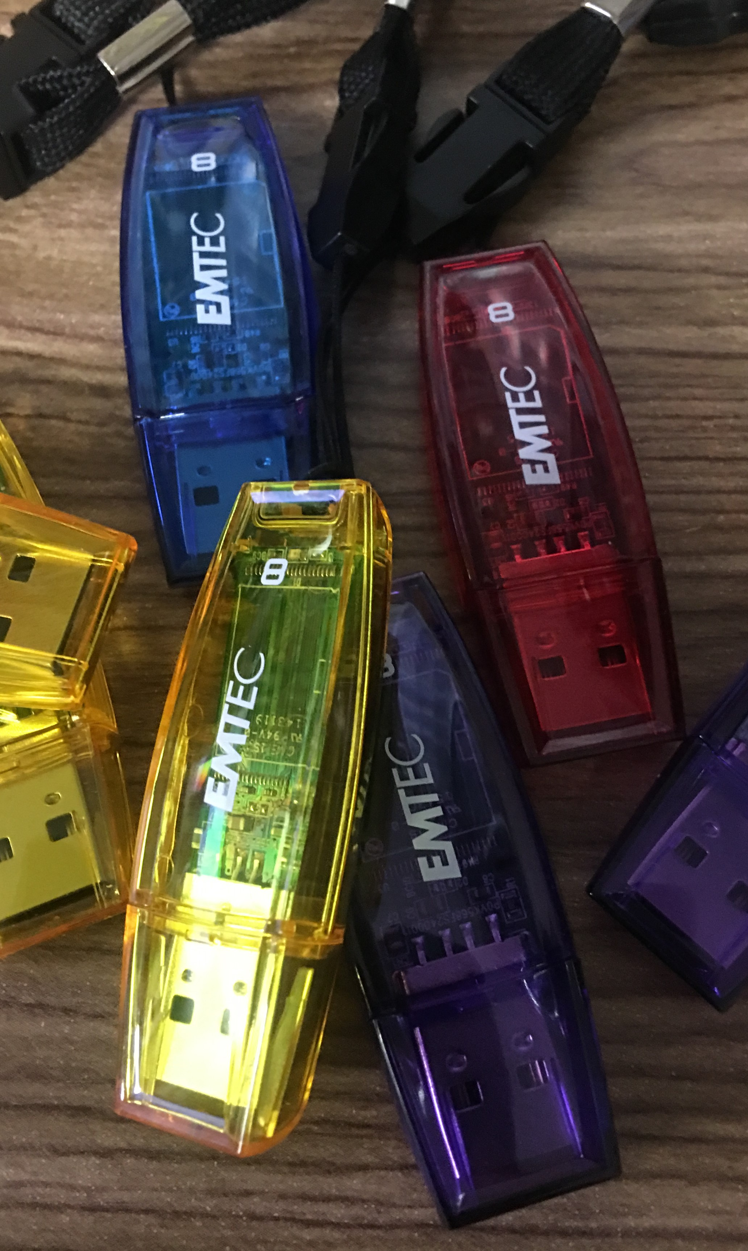
TRAINING VIDEO LIBRARY

Slide 9
HOW TO REACH ME:
GREG DOERSCHING
BULLSEYE MENTOR RECRUITER TRAINING
GRIFFIN SEARCH GROUP
WWW.BULLSEYEMENTOR.COM
GREG@BULLSEYEMENTOR.COM
OFFICE: 414-421-7522
CELL: 414-520-7522

